Slide 1
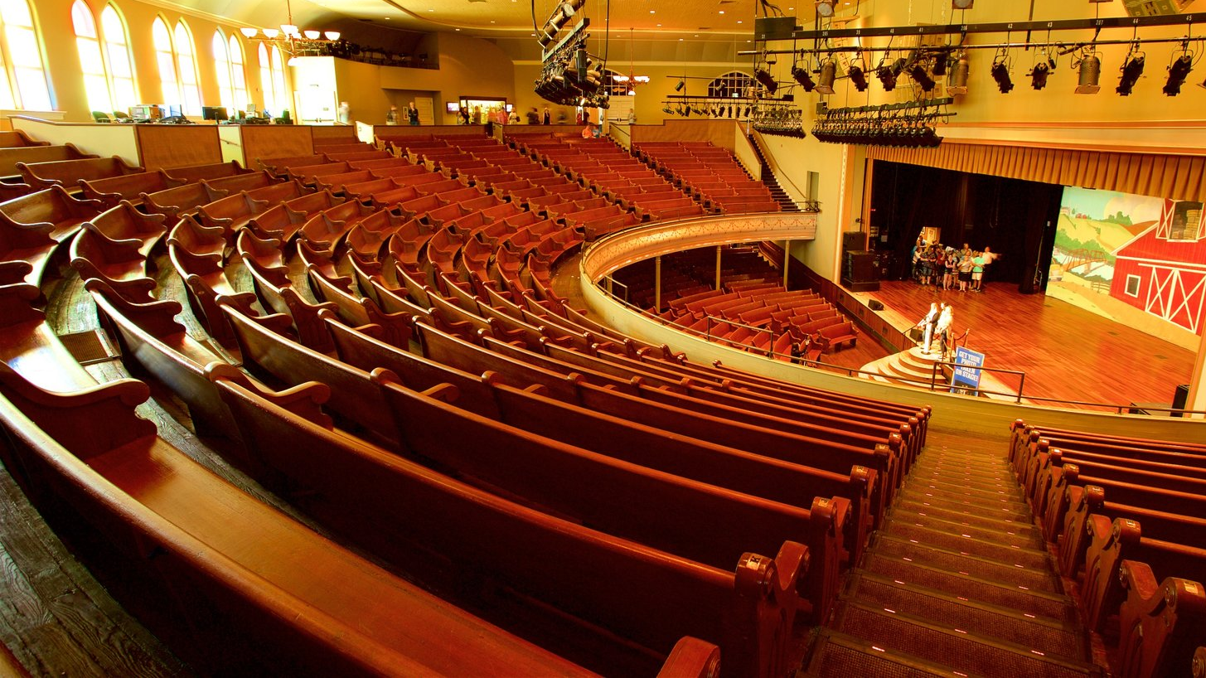
Indoor Image Recognition
INSY 5378 Project
Anagha Shinkar
Ekta Tomar
Gayathri Etraj Janaki
Sathya Pramod Bhat Muniyooru Nataraja

Slide 2

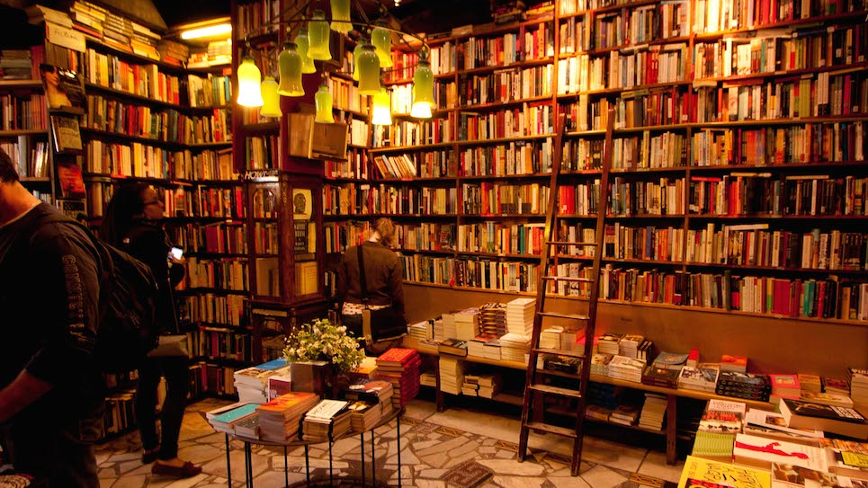
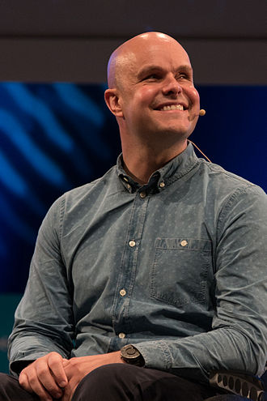



Indoor Image Recognition
A brief idea on what we are trying to accomplish.
Mark Pollock is an international motivational speaker, explorer, and author from Northern Ireland, who became the first blind man to race to the South Pole.
Image Source : Wikipedia

Slide 3

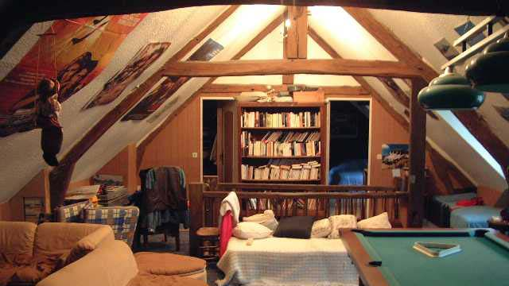
Real time Application
Helps Blind people to recognize the room.
For emergency situations, tracking the mobile camera.
Interior Decorators.

Slide 4
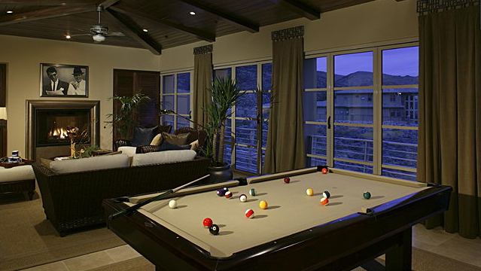
Problem?
The Outdoor scene recognition has been done with most scene recognition models, the challenging problem we face is when it comes to Indoor Scene recognition.
The difficulty we face is when we must differentiate between indoor scenes – Spatial properties and the ones characterized by the objects they contain.

Slide 5
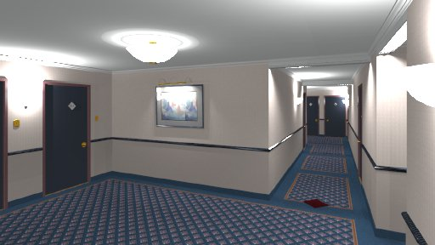
Dataset.
Indoor scene recognition.
Main reference: http://web.mit.edu/torralba/www/indoor.html
It has a total of 67 categories. We have run the model for 21 categories to avoid complexities.
The number of images vary per category, there are at least 100 images per category.
Few examples of categories used: Airport, Art Studio, Auditorium, Bakery, Bar, Bathroom, Bedroom etc.

Slide 6
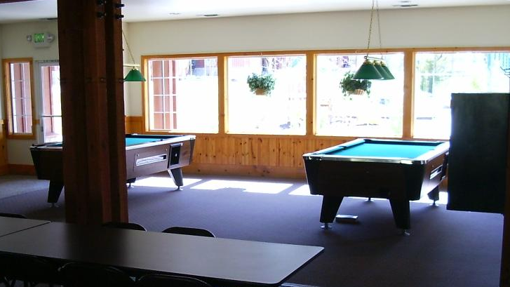
Challenges faced
Getting a viable dataset (Small dataset).
Variation in image size.
Overfitting.

Slide 7
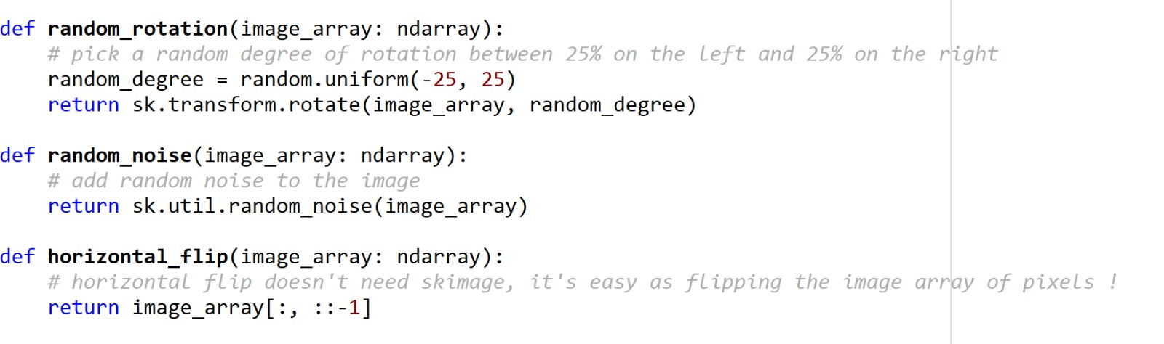
Solution
Used “Keras” API to build deep leaning model.
For small dataset: Image Augmentation
Random rotation
Random noise
Horizontal Flip

Slide 8
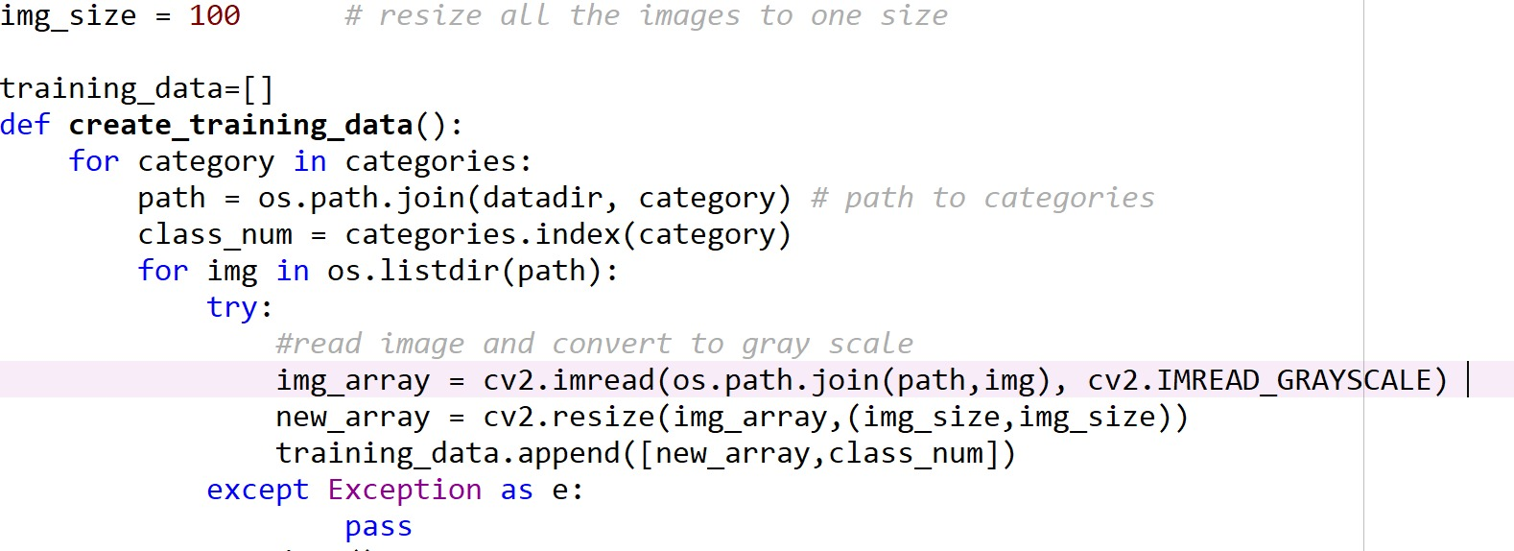
Solution
For Variation in size: compressed all images to uniform size of
100 *100 pixels ( height * width)
Colored images (RGB) makes processing duration large so it was converted into Grayscale.

Slide 9
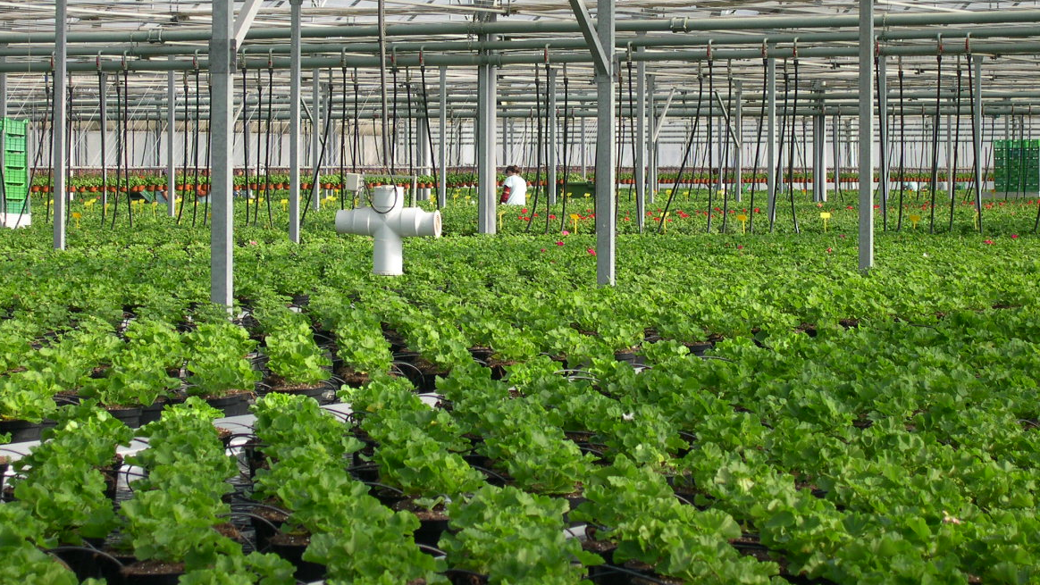
Building the model
Build model using Conv2d layers and dense layers.
Used “relu” and “softmax” as final Activation functions.
To avoid overfitting – utilized dropout function.

Slide 10
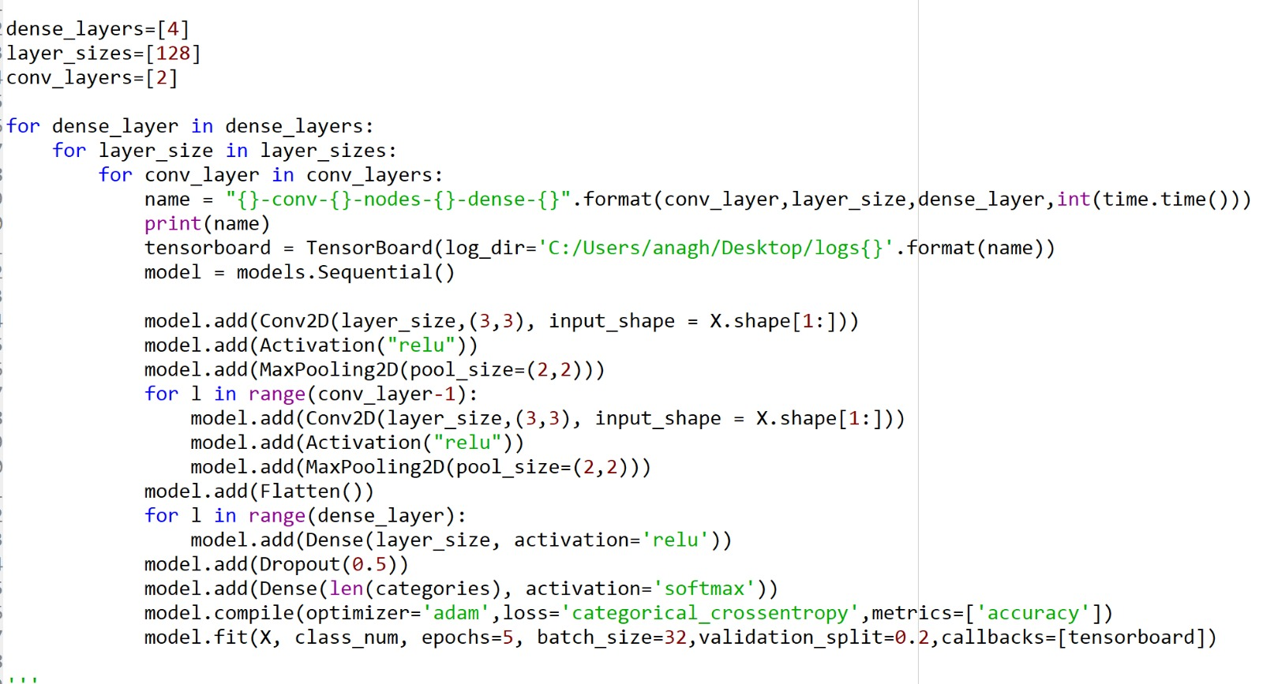
Building the model

Slide 11
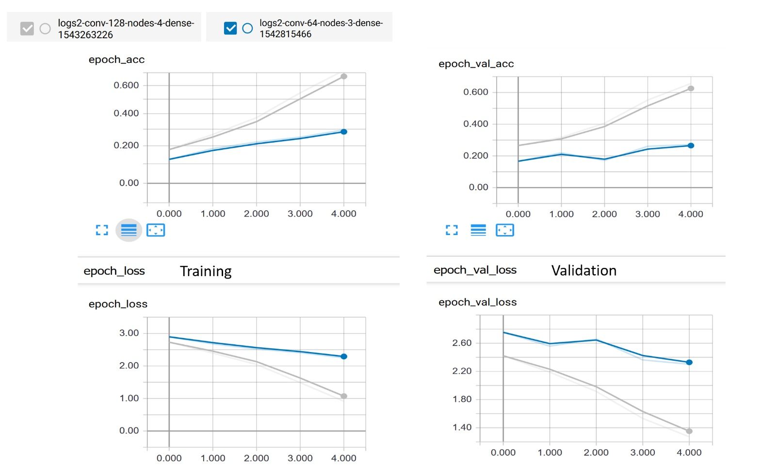
TensorBoard Accuracy and Loss Graphs

Slide 12
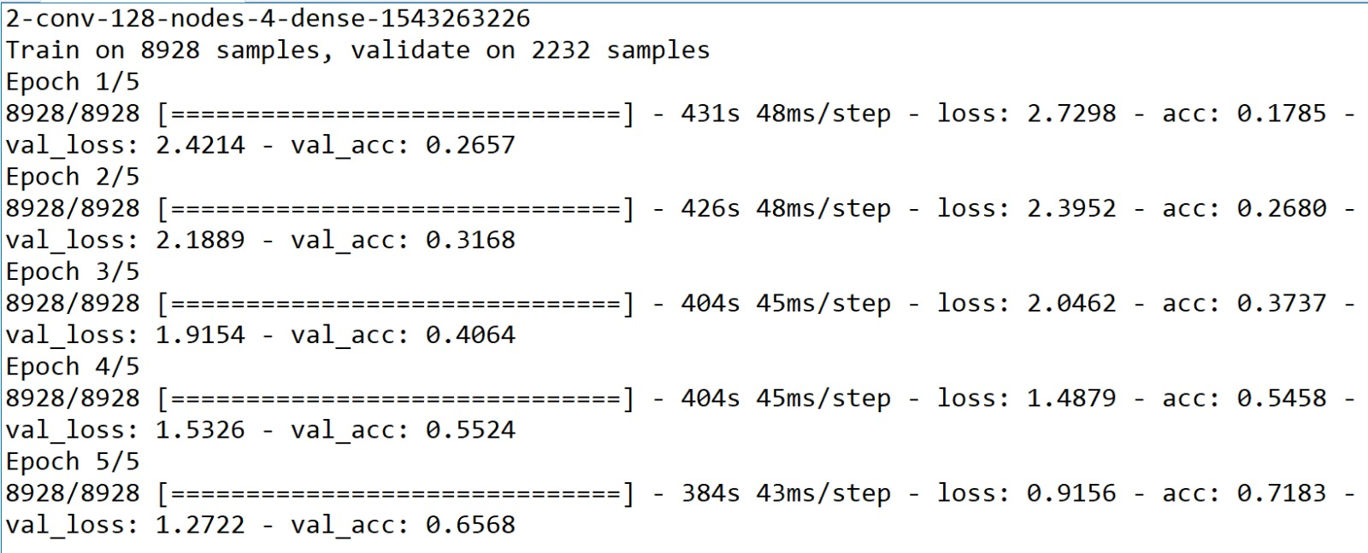
Results

Slide 13

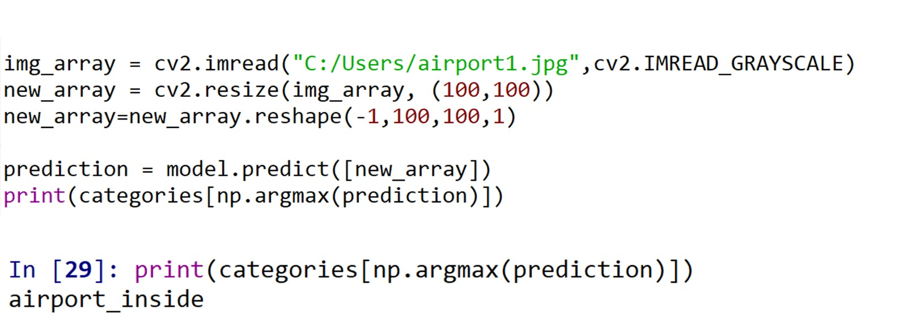
Testing: It WORKS!

Slide 14
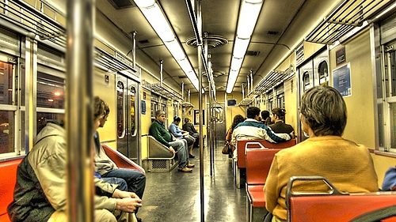
References
http://web.mit.edu/torralba/www/indoor.html
Online video tutorials:
https://becominghuman.ai/building-an-image-classifier-using-deep-learning-in-python-totally-from-a-beginners-perspective-be8dbaf22dd8

Slide 15
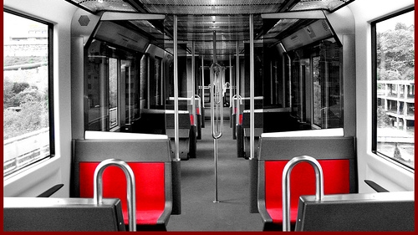
Thank you!

